Slide 1

Customer Personality Analysis and Segmentation
Group 4
Team Member:
Ajit keshav
Harsh Devendra Patil
Amruta
Bhargav Simha
Sravan Kumar
Rutikesh
Syed Yaseen Ali

Slide 2
Project Objective
Goal: Analyse customer behaviour and spending patterns.
Action: Segment customers into distinct groups (clusters).
Outcome:
1. Enable targeted marketing campaigns.
2. Improve customer satisfaction.
3. Optimize product offerings.

Slide 3


Slide 4
Understanding the Dataset
Dataset Overview:
Contains customer demographics, purchasing habits, and engagement metrics.
Key Attributes:
1. Demographics: Age, marital status, income.
2. Behaviour: Spending on wine, meat, fruits, etc., over two years.
3. Engagement: Last purchase date, campaign responses, and complaints.

Slide 5
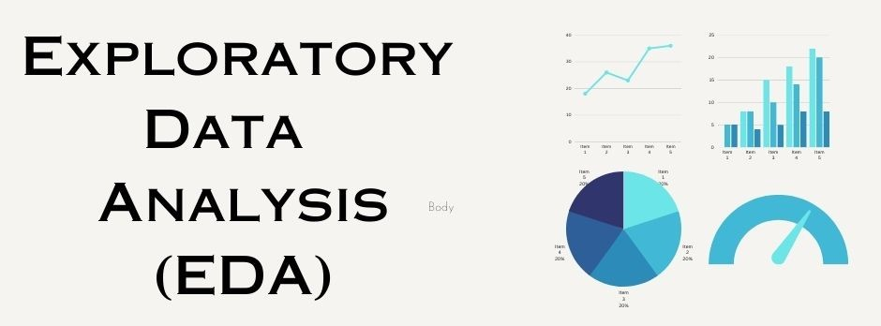

Slide 6
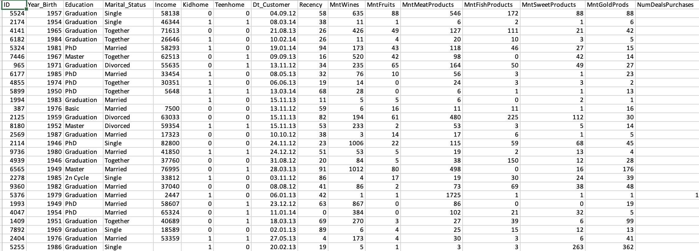
Dataset Overview

Slide 7
EDA - Insights from Data
EDA Insights:
1. Age: Most customers are aged 30-50.
2. Spending: High income correlates with high spending on wine.
3. Complaints: Customers with complaints tend to spend less.

Slide 8
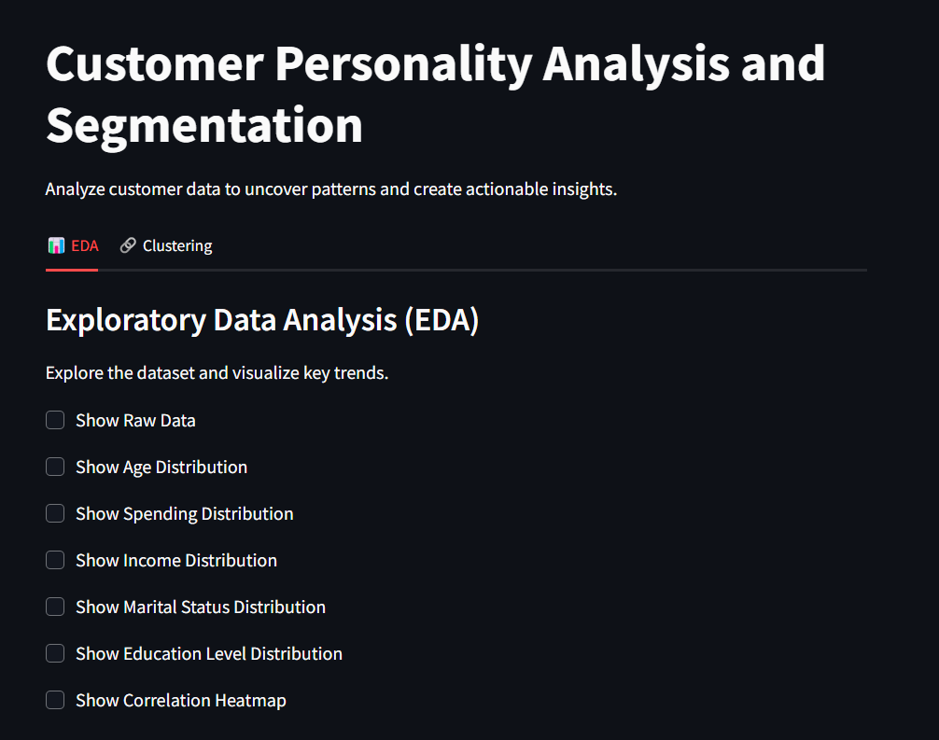
Interactive Deployment with Streamlit on EDA

Slide 9
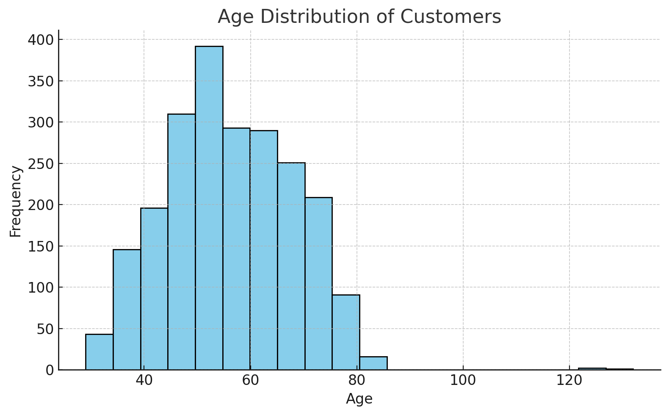
EDA - Insights of Age

Slide 10
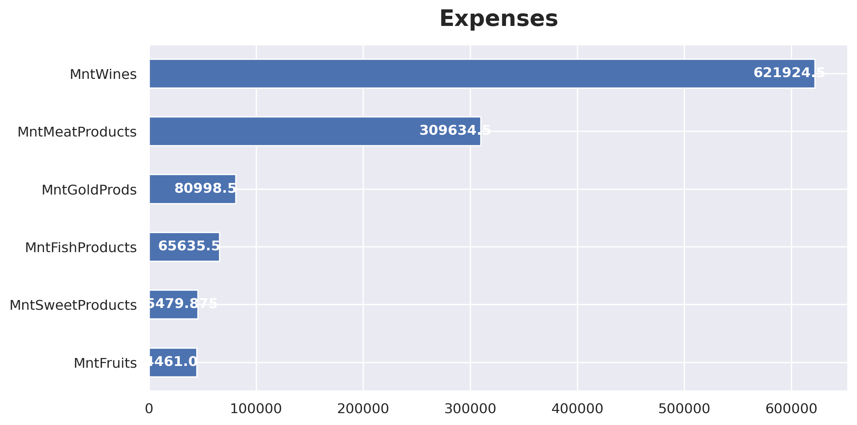
EDA – Insights of Expenses

Slide 11
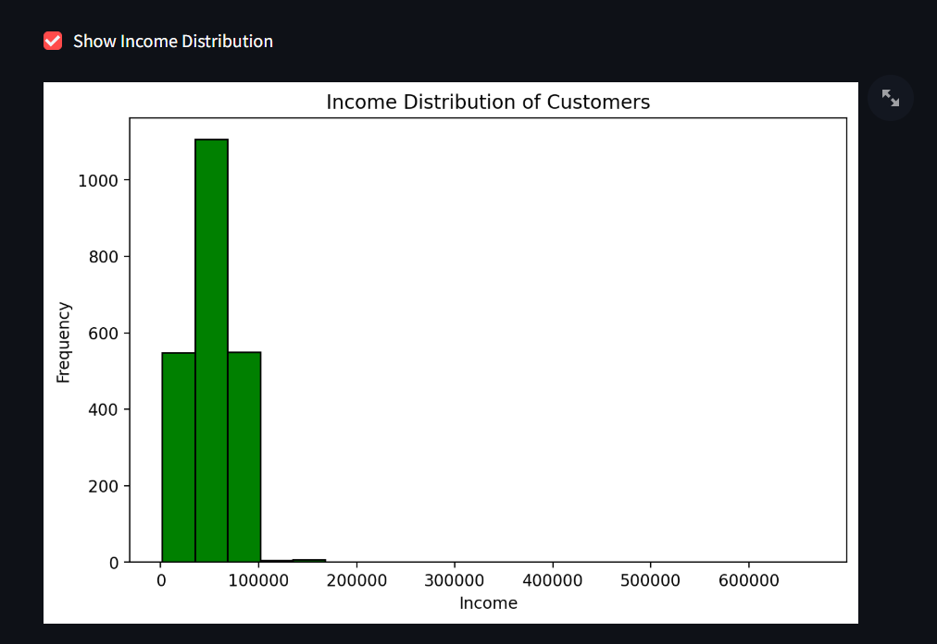
EDA- Insights of Income

Slide 12
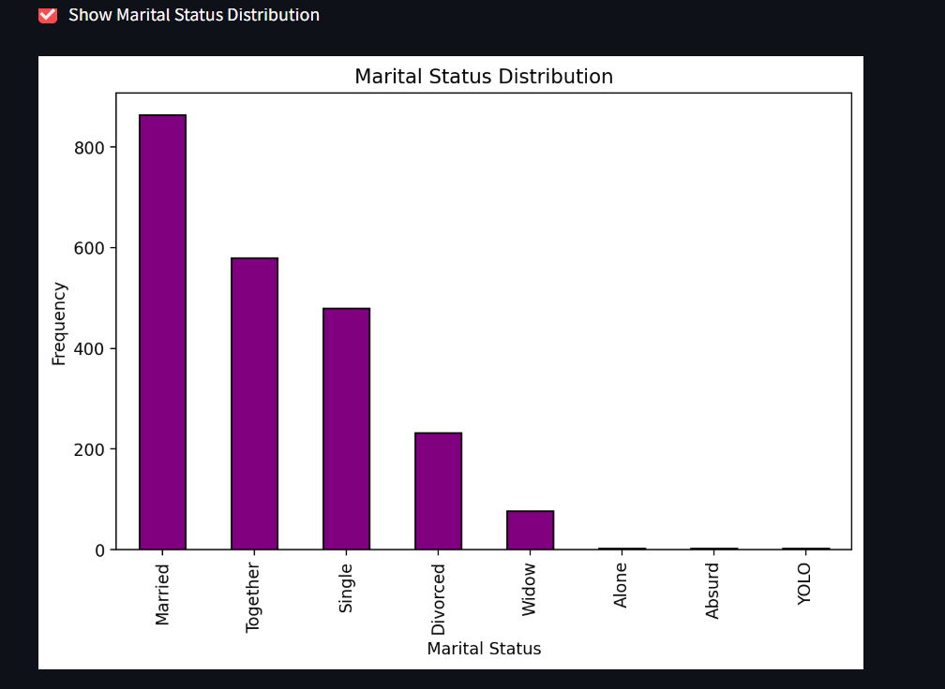
EDA – Insights of Marital Status

Slide 13
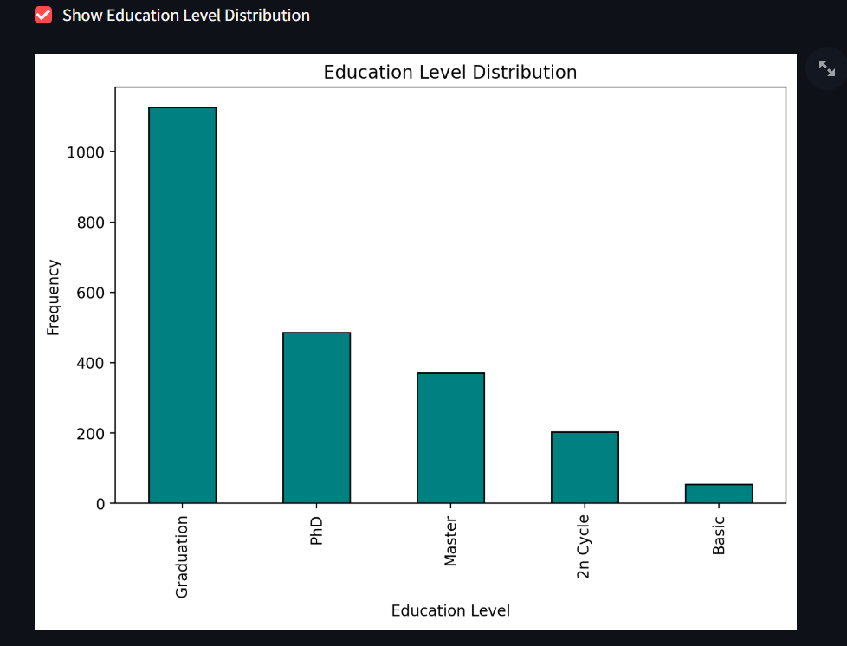
EDA- Insights of Education

Slide 14
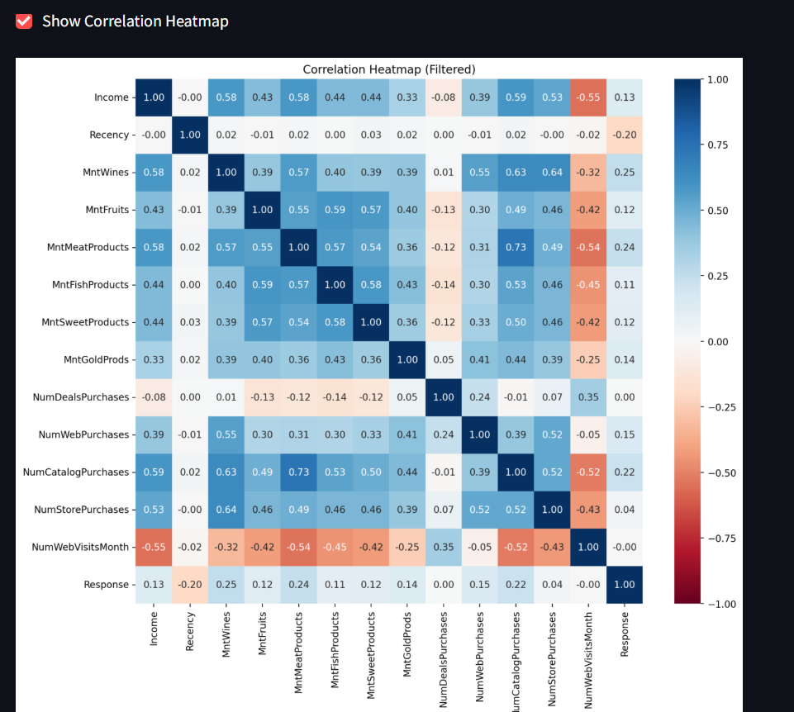
EDA - Insights from Heatmap

Slide 15
Model Building

Slide 16

Clustering - Methods and Goals
Clustering Purpose: Groups customers based on behaviour and traits.
Algorithms Used:
1. KMeans: Creates a fixed number of clusters; ideal for general segmentation.
2. DBSCAN: Identifies dense clusters and marks outliers.
3. Agglomerative Clustering: Builds a hierarchy to show relationships between clusters.

Slide 17

Clustering - Methods and Goals
Clusters reveal groups like:
Luxury Buyers: High spending on wine and gold.
Discount Seekers:
Frequent but low-cost purchases.

Slide 18
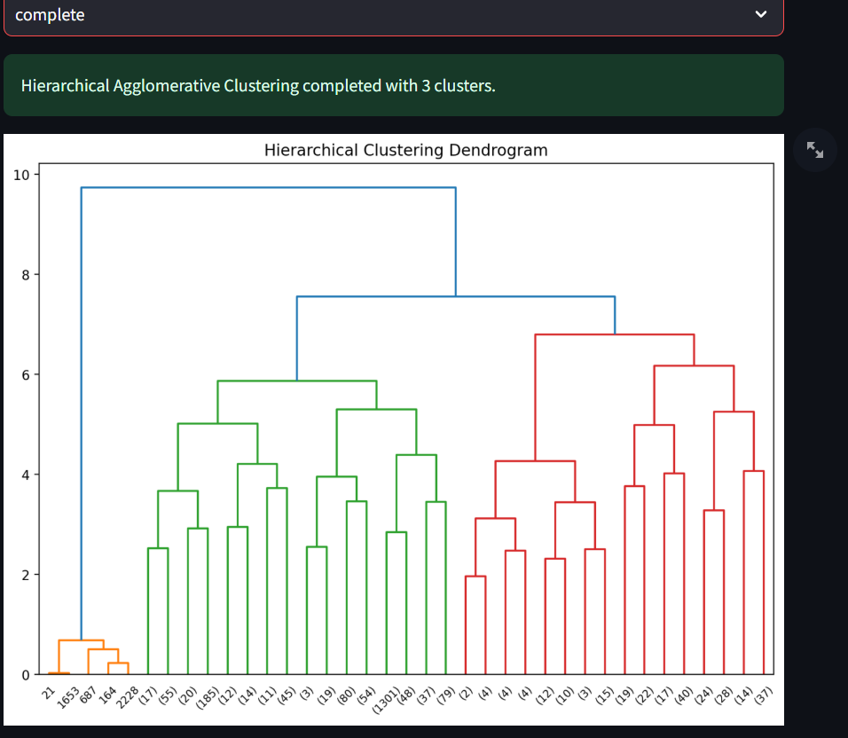
Hierarchical agglomerative clustering

Slide 19
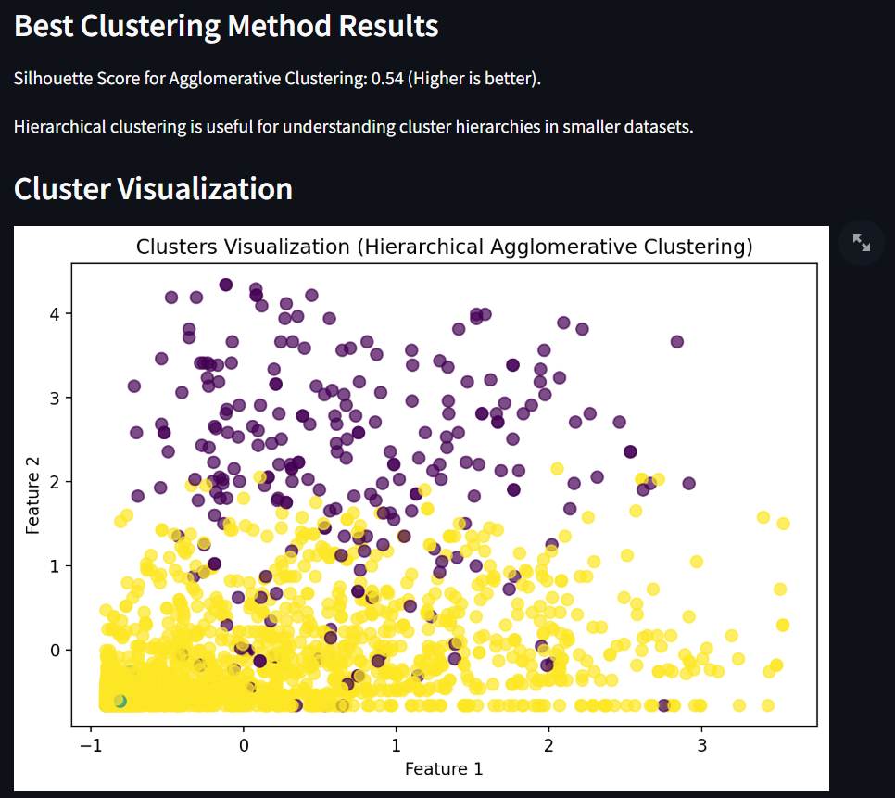
Hierarchical agglomerative clustering

Slide 20
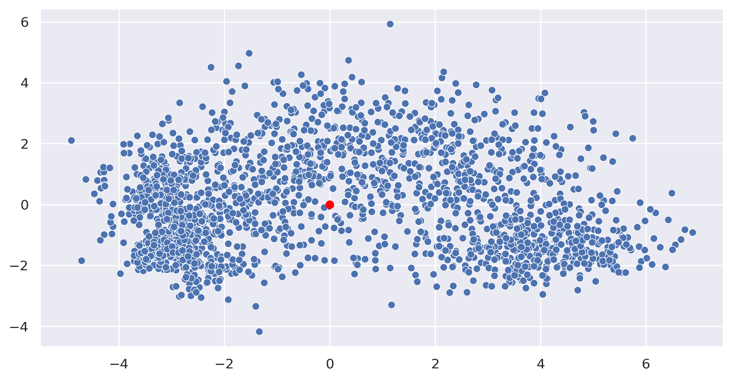
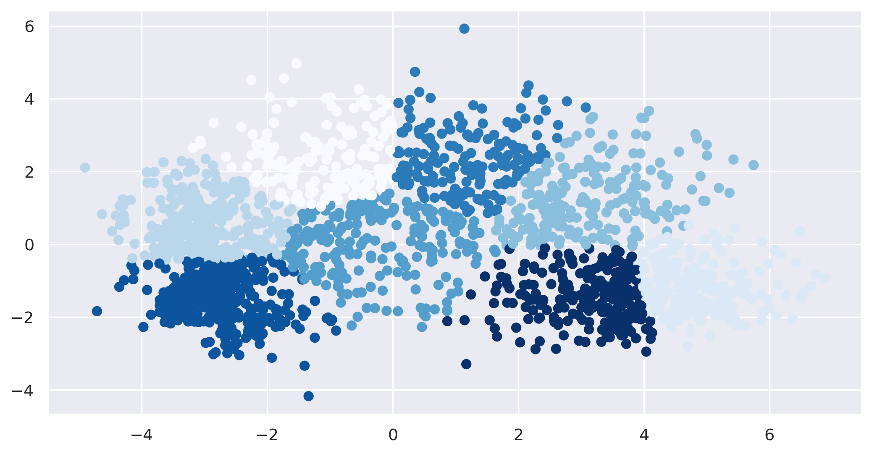
K-Means Clustering before applying K-means algorithm

Slide 21
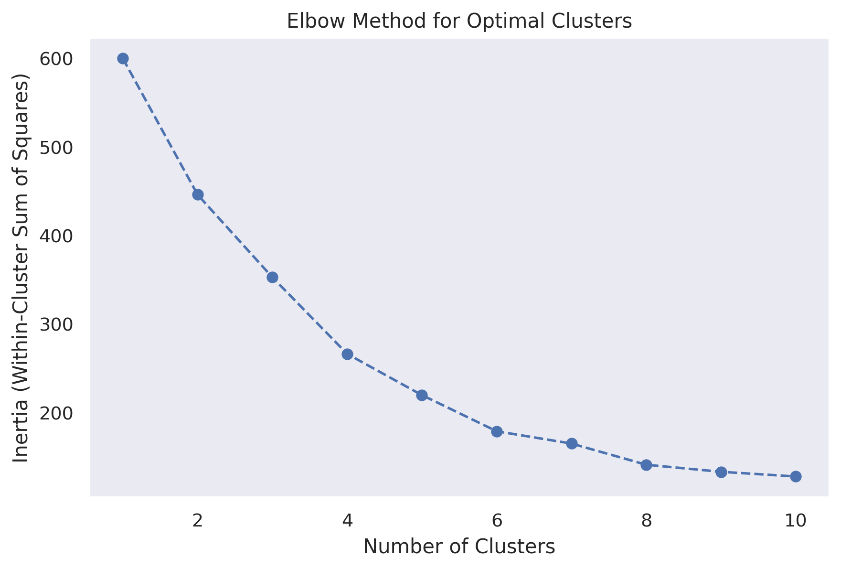
Elbow Method for K-Means Clustering

Slide 22
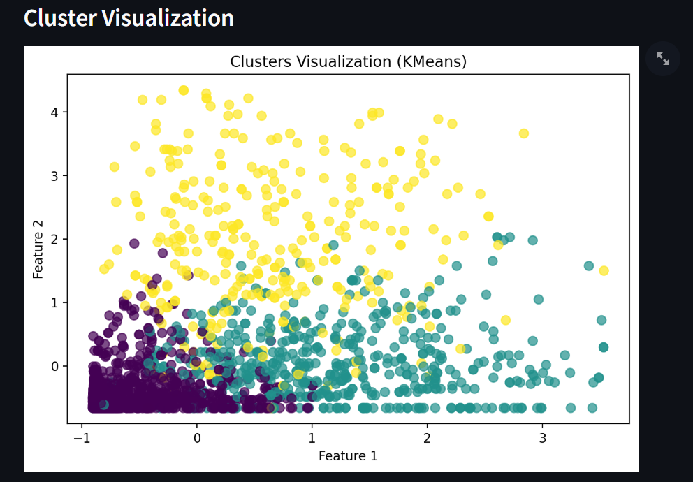
K-Means Clustering

Slide 23
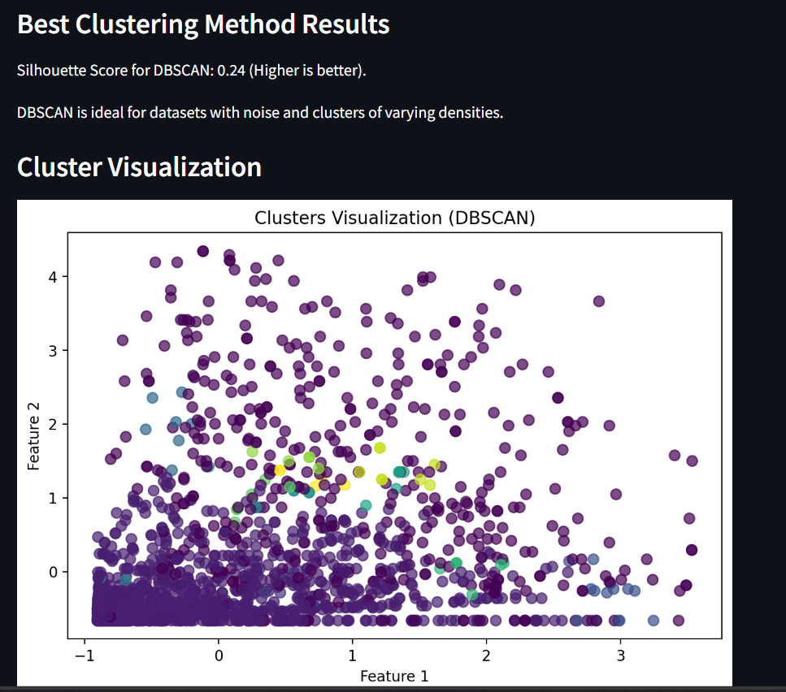
DBSCAN Clustering

Slide 24
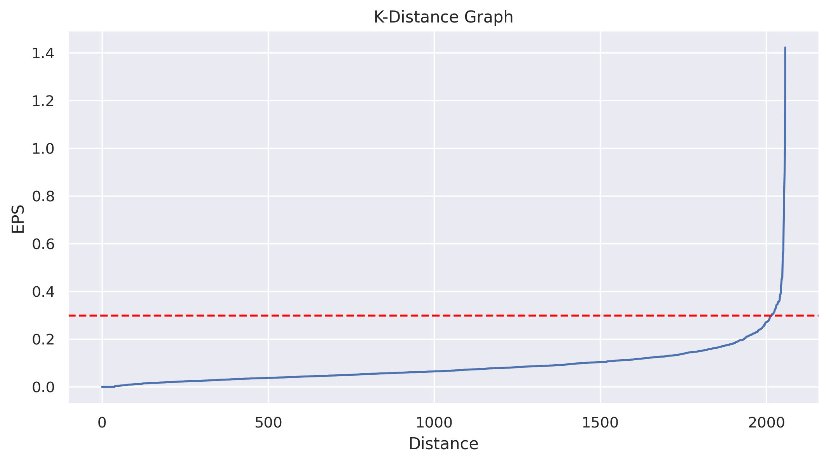
DBSCAN Clustering

Slide 25
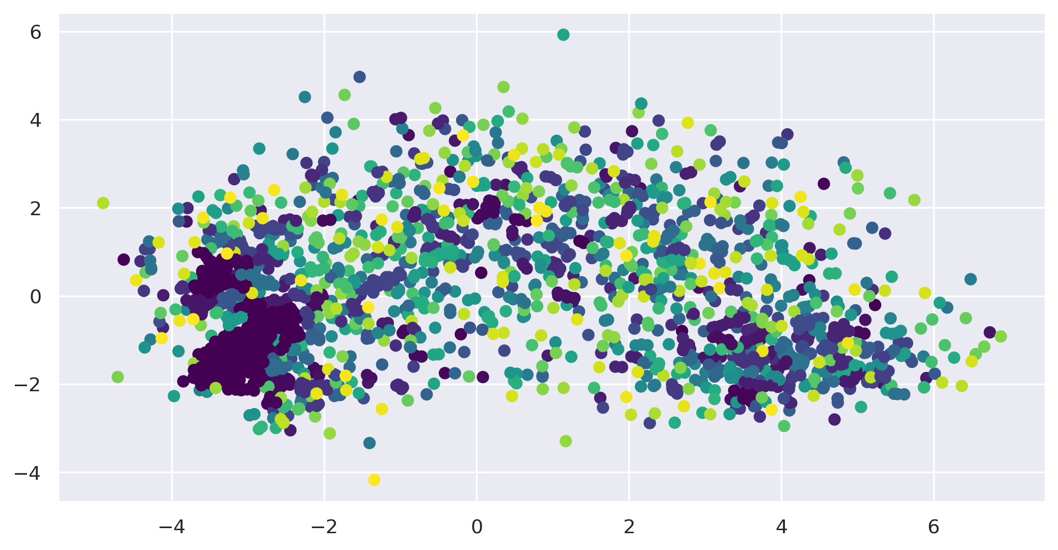
DBSCAN Clustering

Slide 26
Matching Clusters to categories
1.Understand Cluster Characteristics
2. Compare Features Across Clusters
3. Profile the Clusters
4. Visualize Cluster Features

Slide 27
Model Evaluation

Slide 28
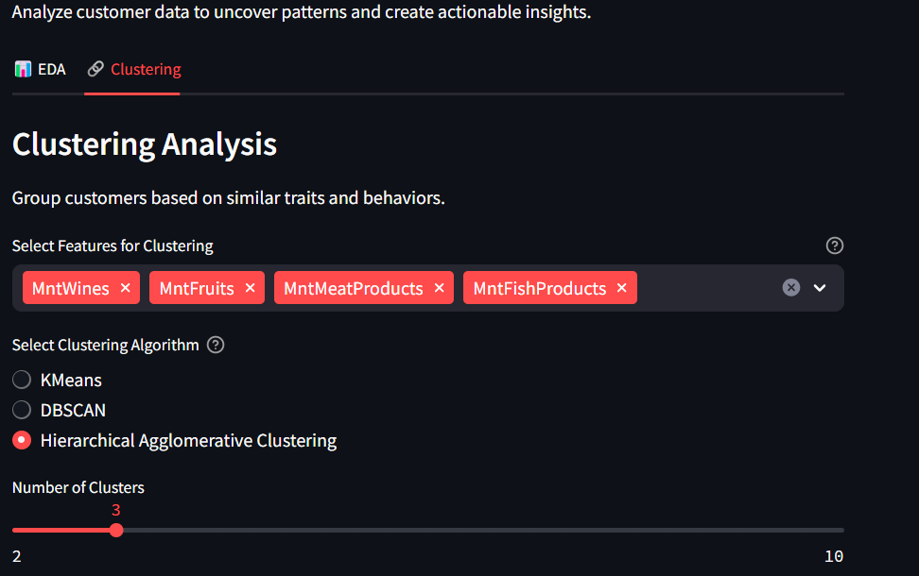
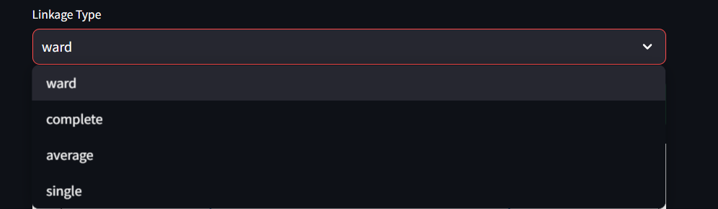
Results of Hierarchical Agglomerative Clustering:

Slide 29
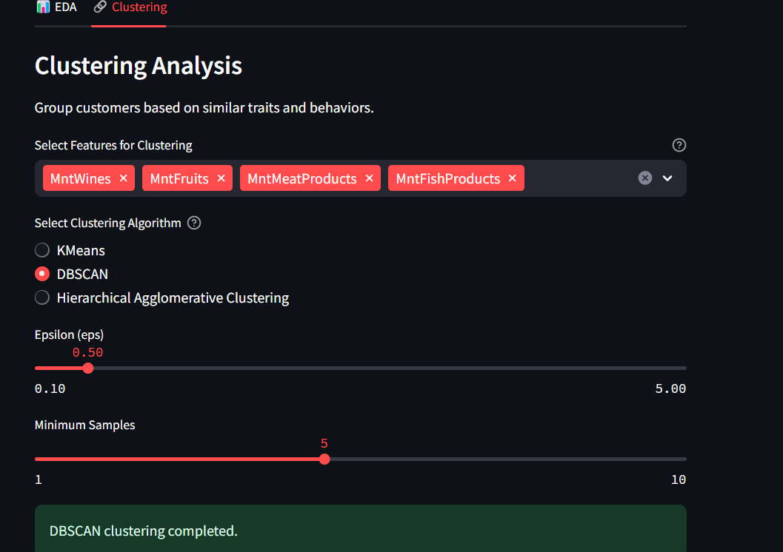
Results of DBScan :

Slide 30
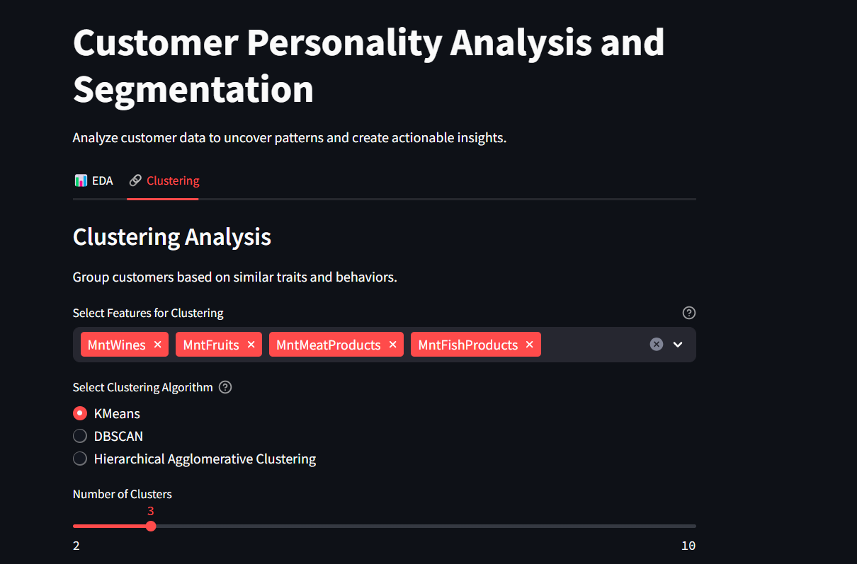
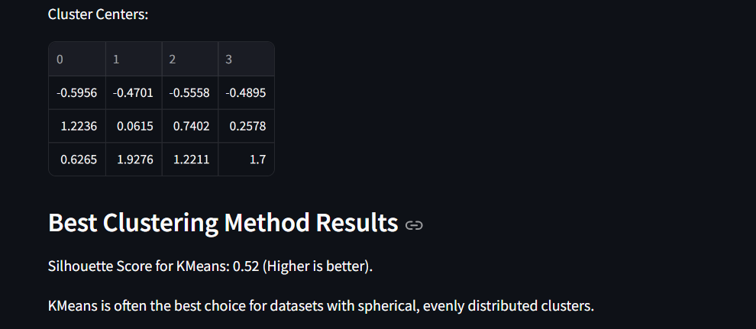
Results of Kmeans:

Slide 31
Problem faced while doing this project
Handling Missing Values:
The Income column has 24 missing values.
Solution: Use imputation techniques (mean/median) or remove rows if they significantly impact analysis.
Outlier Detection:
Income has extreme values (e.g., max value: 666,666).
Solution: Identify and handle outliers using techniques like IQR or Z-score analysis.
Feature Engineering:
Create new features such as Age (2025 - Year_Birth) or Total_Spending (sum of all Mnt* columns).
Solution: These derived features can improve clustering and prediction models.
Data Normalization/Scaling:
Columns like Income and MntWines have varying scales.
Solution: Apply scaling techniques (e.g., StandardScaler) before feeding data into machine learning models.
Clustering and Customer Segmentation:
Perform clustering algorithms (KMeans, DBSCAN) on spending-related features (MntWines, MntFruits, etc.).
Goal: Identify customer segments for targeted marketing strategies.

Slide 32
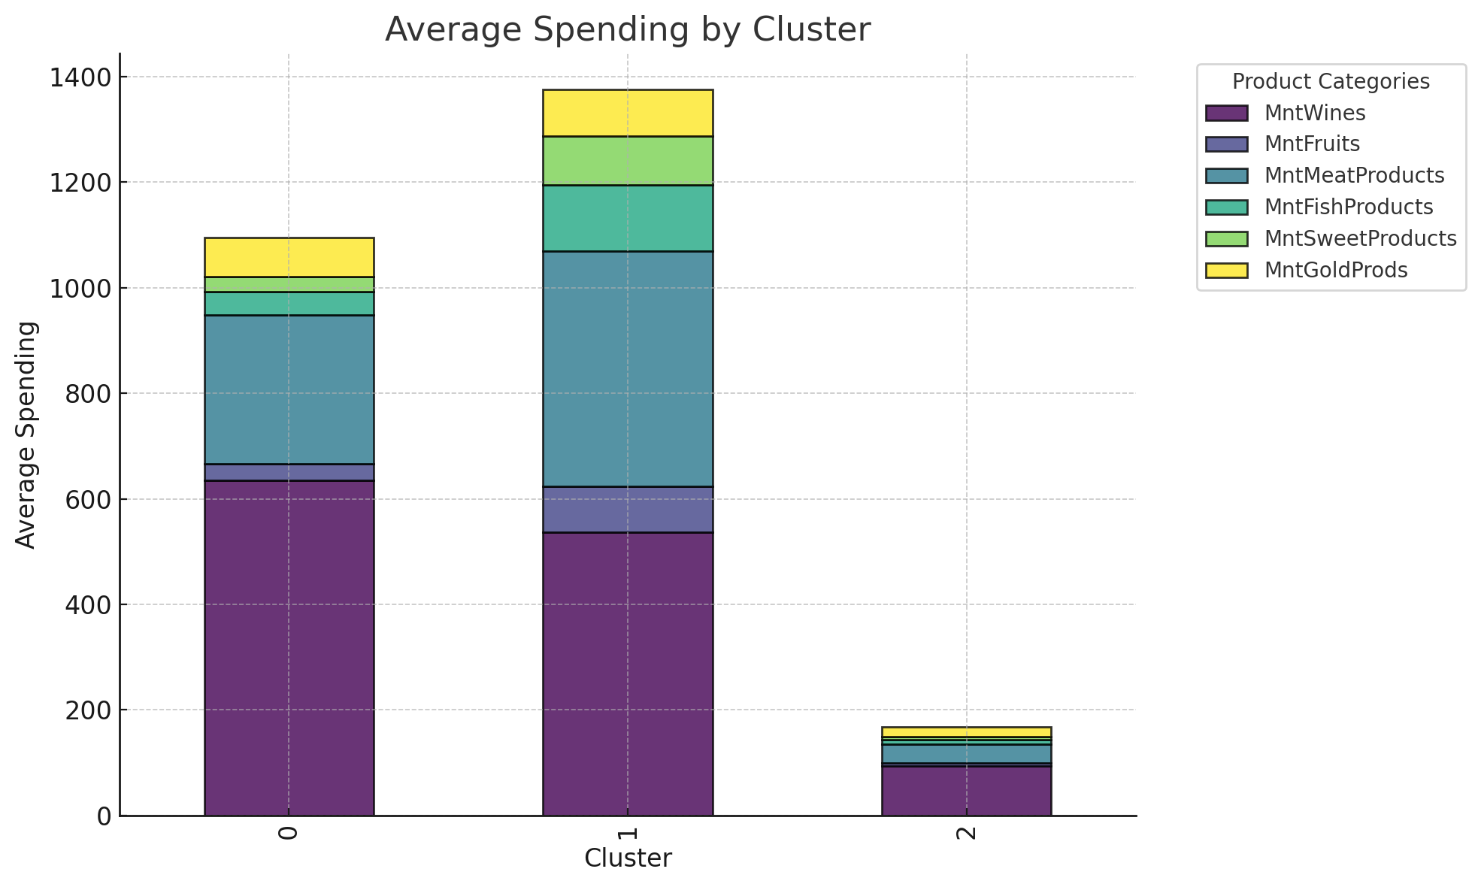
Insights from Clustering

Slide 33
Interactive Deployment with Streamlit
Deployment: Project deployed as an interactive web app using Streamlit.
Features:
1. Enable PCA for dimensionality reduction.
2. Choose clustering methods (KMeans, DBSCAN, Agglomerative).
3. Visualize results dynamically.
Example Workflow:
Select KMeans.
Set clusters to 4.
View customer segmentation on a scatter plot.

Slide 34
Insights of Deployment using Streamlit

Slide 35

Conclusion
1. Data Quality and Preprocessing Are Crucial:
- Handling missing values, outliers, and inconsistent data is foundational for building reliable models.
- Example: Imputation of missing `Income` values ensured data integrity and reduced bias in clustering results.
2. Feature Engineering Drives Model Performance:
- Derived features like `Age` and `Total_Spending` provided deeper insights and improved clustering accuracy.
- Example: Calculating `Age` from `Year_Birth` revealed key customer age demographics.
3. Visualizations Enable Better Understanding:
- Graphs like histograms, bar charts, and heatmaps revealed patterns in spending, age distribution, and income levels.
- Example: Spending distribution across product categories helped identify high-revenue segments.
4. Clustering Revealed Actionable Customer Segments:
- Algorithms like "KMeans" and "DBSCAN" successfully grouped customers based on spending behavior and income.
- Example: KMeans clustering identified distinct customer groups for targeted marketing campaigns.
5. Evaluation Metrics Guide Decision-Making:
- Metrics like "Silhouette Score" ensured the selected clustering models produced meaningful insights.
- Example: The Silhouette Score validated that KMeans created well-defined clusters.

Slide 36

THANK YOU !

